Slide 1
Intro to Design Patterns
Lecture 1.1 – Strategy Pattern

Slide 2
Notes About Code & Presentation
Code Style
Compressed to fit in vertical space
Namespaces
Used to support code folding and group evolution of code
Comparisons
Code presented side-by-side as much as possible
Text and Other Explanations
Typically on slide before code to maximize space for the code itself
Expect namespaces: <DP>_legacy, <DP>_problem, <DP>_solution
Read the comments

Slide 3
Reading
DPE
Chapter 1 – The Object Oriented Paradigm
Chapter 3 – A Problem that Cries Out for Flexible Code
Chapter 4 – A Standard Object-Oriented Solution
Chapter 5 – An Introduction to Design Patterns
Chapter 9 – The Strategy Pattern

Slide 4
5 Principles of Design Patterns
Abstract what varies
Domain (x) versus range(s) (y, z, w)
Open/closed principle
Open to addition
Closed to modification
DRY Principle (Don’t Repeat Yourself)
Combinatorial explosions
Coupling and cohesion

Slide 5
If the Algorithms are varying use the Strategy pattern
Technique
Class hierarchy for algorithms.
One or more virtual methods.
Domain class.
Mapping logic.
Benefits
Client code uses classes polymorphically.
Follows open/closed principle.
Alternatives suffer from coupling, code duplication, multiple seam points, violate open/closed principle, and require error handling.

Slide 6
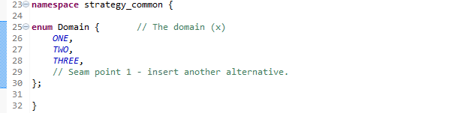
Code Common to the Lecture Examples
The domain

Slide 7
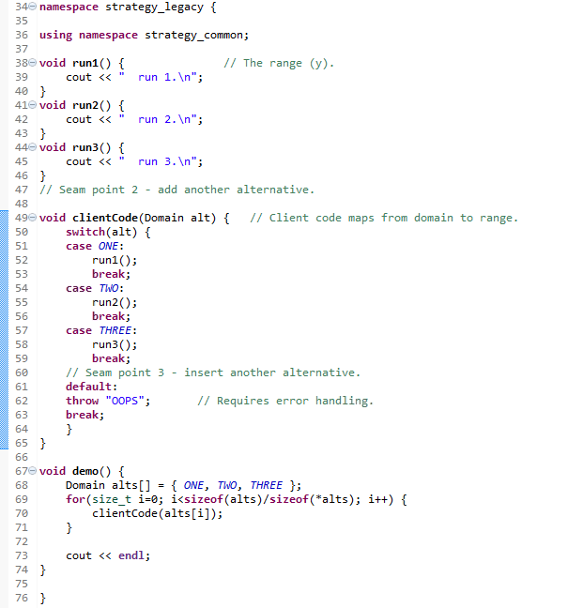
Legacy Example
Client code mixes domain/range mapping with execution code.

Slide 8
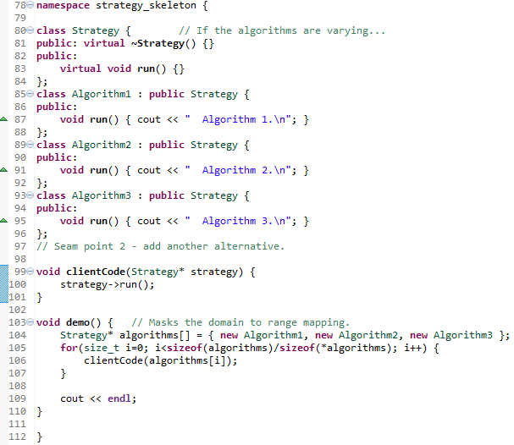
Skeleton Example
Single inheritance tree.
One or more virtual methods.
Client uses code polymorphically.
Demo hides domain/range mapping.

Slide 9
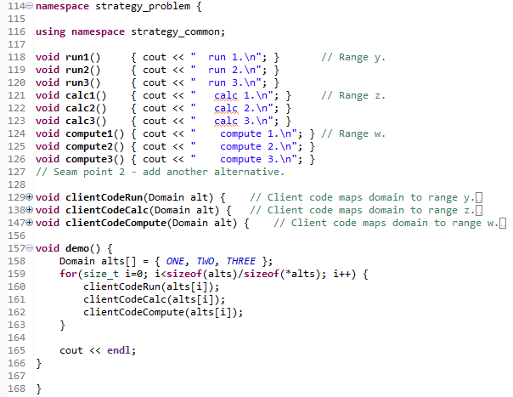
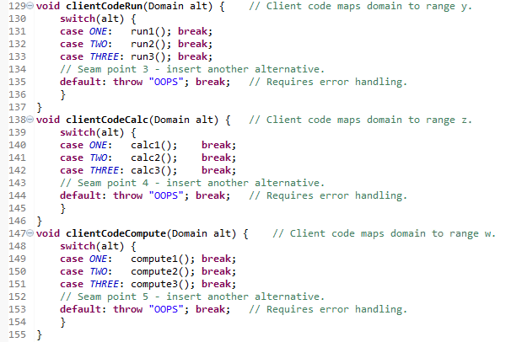
Problem Example
Multiple seam points.
Strong coupling, DRY, etc.

Slide 10
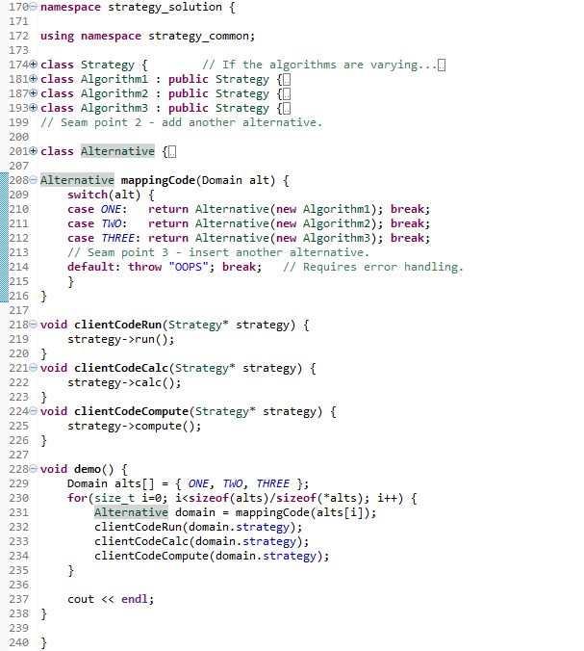
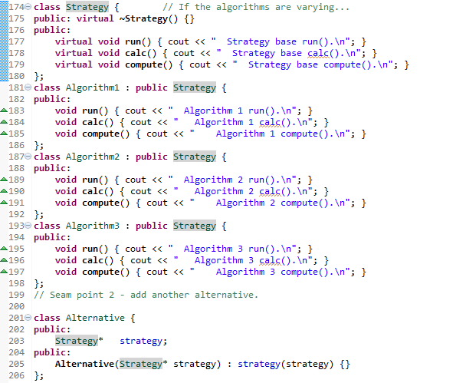
Solution Example

Slide 11
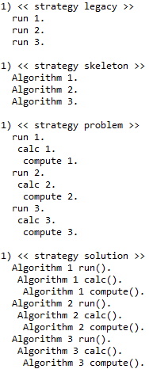
Output

Slide 12
Modeling Variation by State
Some variations can be modeled as built-in types.
Others with structures.
Call both Plain Old Data (POD) types.
POD types allow us to model variations that can be captured as state.
Consider modeling tax rates that depend on US state.
namespace antiPattern_: client code violates open/closed principle
namespace abstract_: client code is closed to modification, but state mapping is missing
namespace vary_: state mapping can be by POD, no need for design patterns

Slide 13
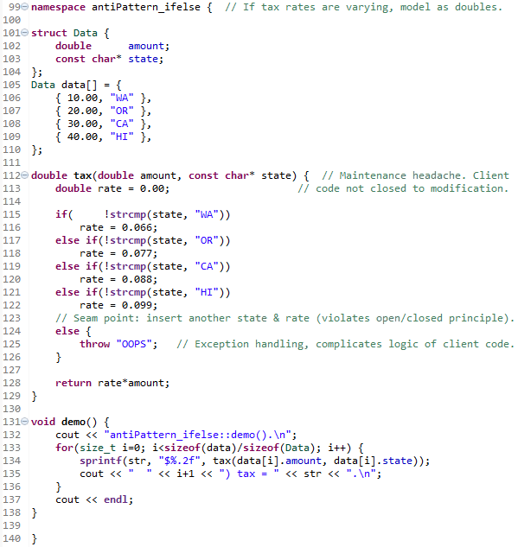
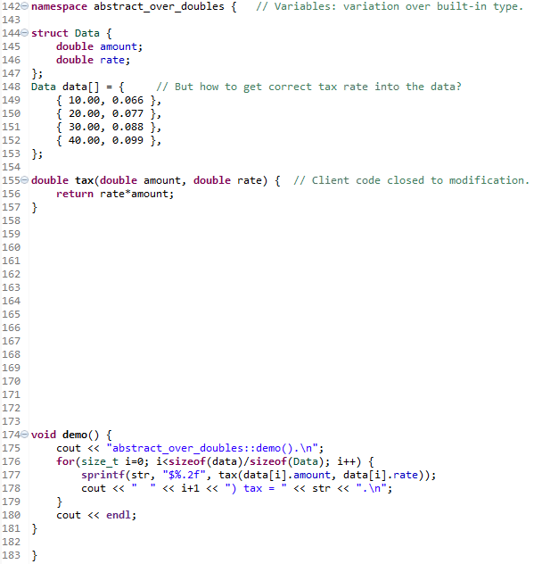

Slide 14
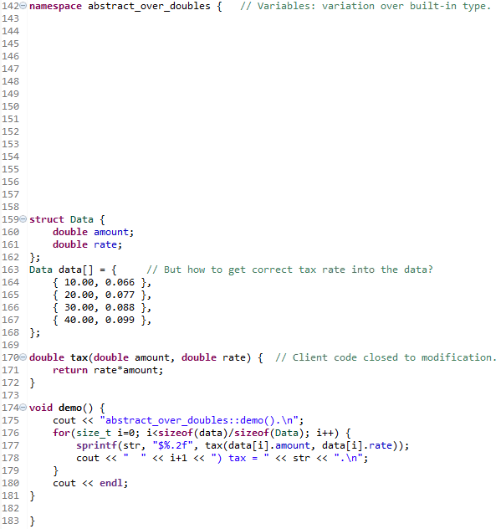
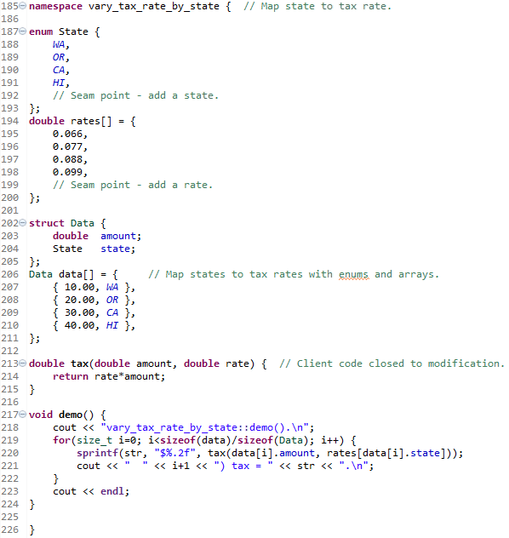

Slide 15
Modeling Variation by Polymorphism
Some variations can NOT be modeled as POD types.
Consider modeling tax algorithms that depend on country.

Slide 16
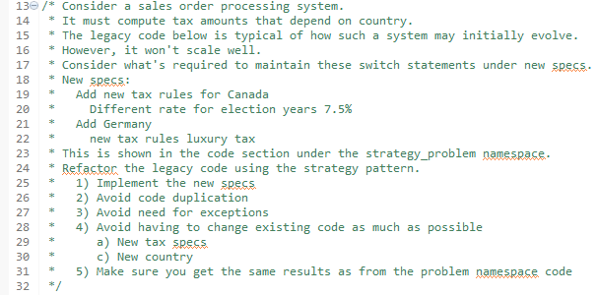
Homework

Slide 17
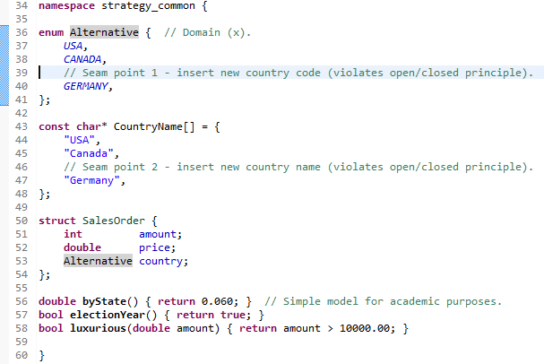
Code Common to the Homework
The domain is the countries.
The range is the tax strategies.
The enums and arrays result in 2 seam points where existing code has to be modified - violates open/closed principle.

Slide 18
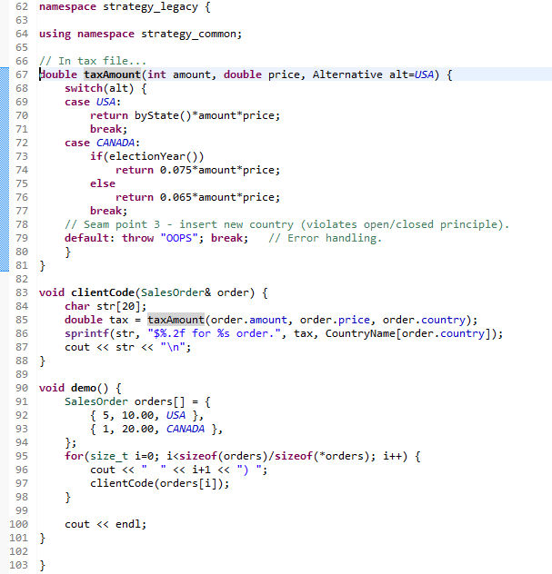

Legacy Example
A 3rd seam point, violates open/closed principle.
Requires error handling.

Slide 19
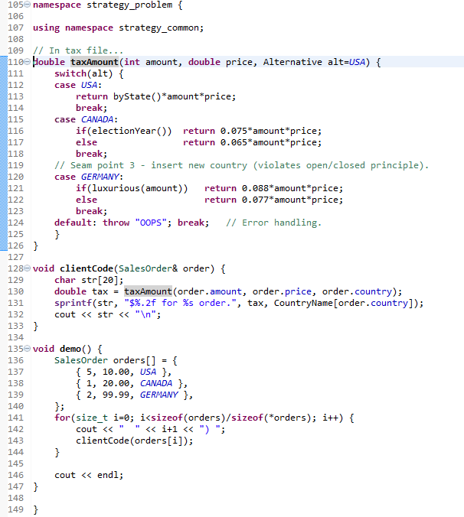

Problem Example
Still have a 3rd seam point, violates open/closed principle.
Still requires error handling.

Slide 20
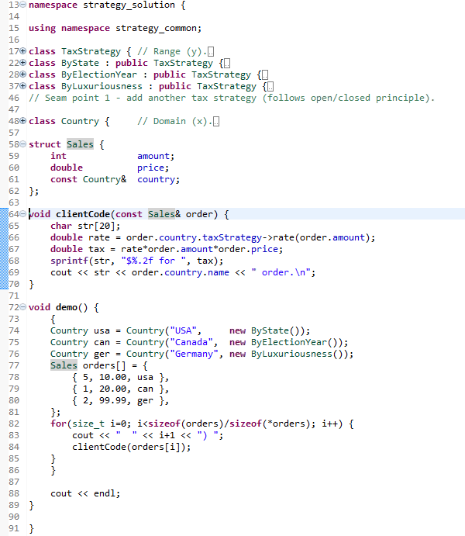
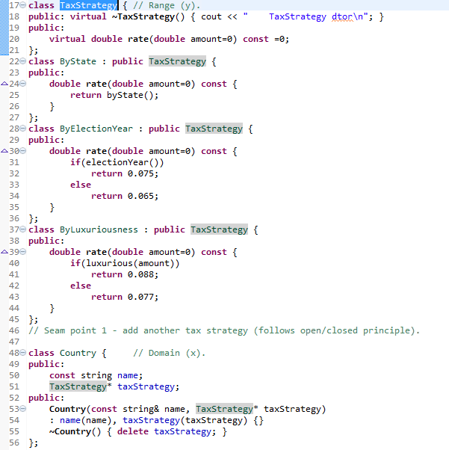
Solution Example

Slide 21
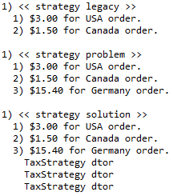
Output

Slide 22
Summary
When the algorithms are varying, use the Strategy pattern to encapsulate the variations.
Large if-else and switch statements are a code smell.
If the variations can be modeled as POD, don’t need a design pattern.
Favor composition over inheritance, particularly when one domain drives multiple ranges:
Tax algorithm depends on country
Date format depends on country
Shipping depends on country.
Etc…

Slide 23
Class Progress
If the algorithms are varying
If the interfaces are varying
If the API’s are varying
If the steps are varying
If the classes are varying
If the options are varying
If the listeners are varying
If the responders are varying
If abstract’n & implement’n vary
If the families are varying
Use the Strategy pattern
Use the Adapter pattern
Use the Facade pattern
Use the Template Method pattern
Use the Factory Method pattern
Use the Decorator pattern
Use the Observer pattern
Use Chain of Responsibility pattern
Use the Bridge pattern
Use the Abstract Factory pattern

Slide 24
Backup Slides

Slide 25
Modeling Variation by Polymorphism
Some variations can NOT be modeled as POD types.
Consider modeling tax algorithms that depend on country.
namespace antiPattern_: client code violates open/closed principle
namespace abstract_: client code is closed to modification, but country mapping is missing
namespace vary_: country mapping can be done by POD or composition
But POD scales badly when one domain (country) drives multiple ranges
Taxes
Date format
Shipping
Etc…
Prefer composition

Slide 26
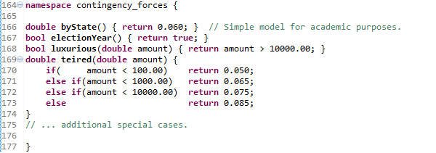
Contingency forces needed by algorithms

Slide 27
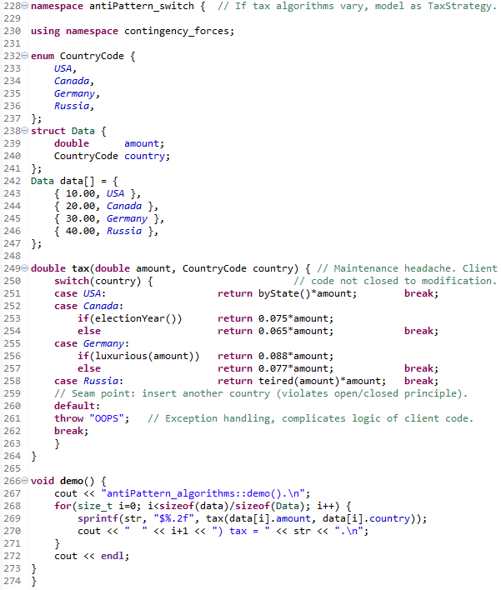
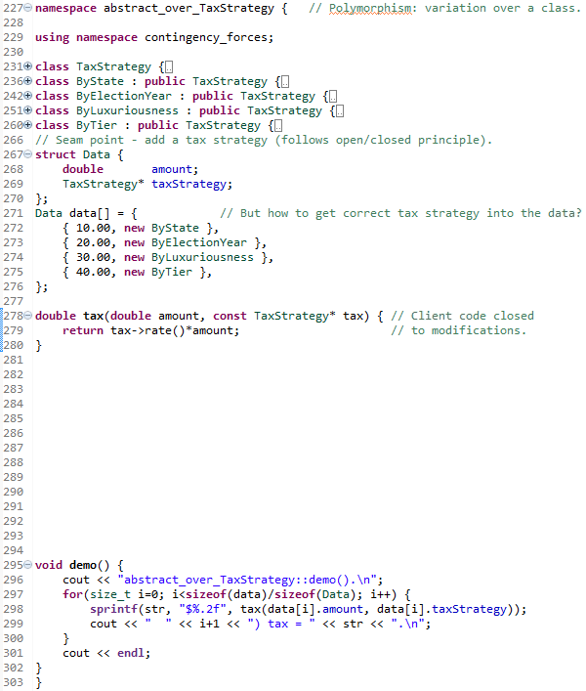

Slide 28
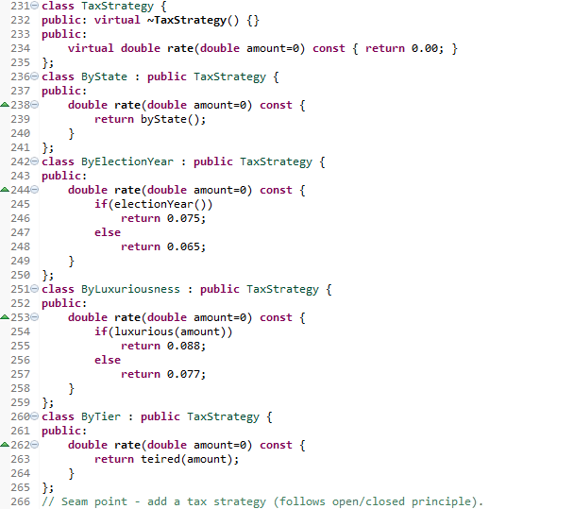
TaxStrategy Class Hierarchy Expanded

Slide 29
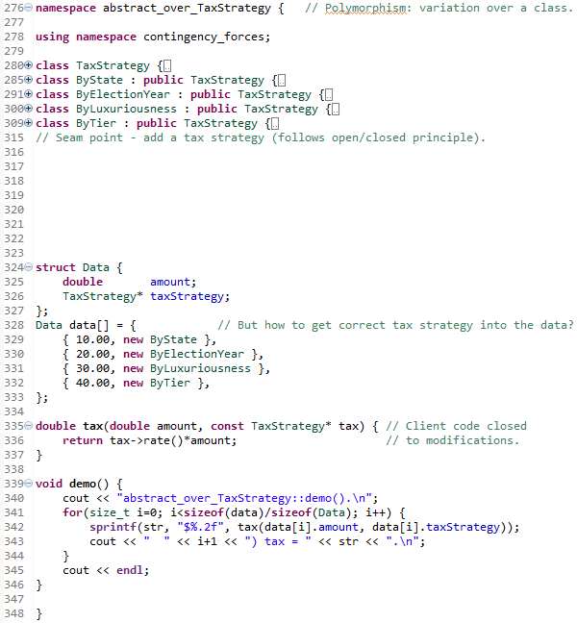
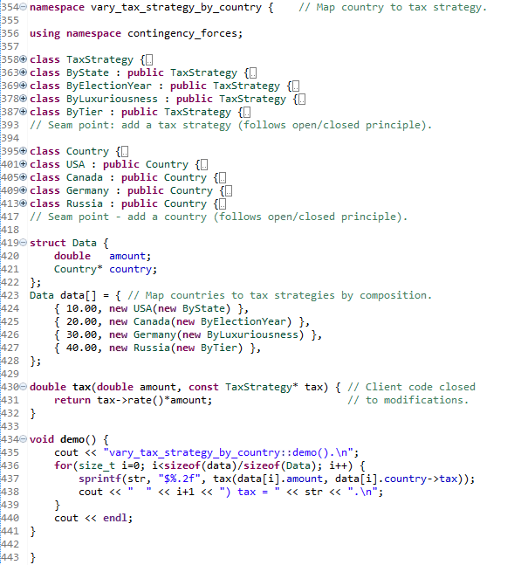

Slide 30
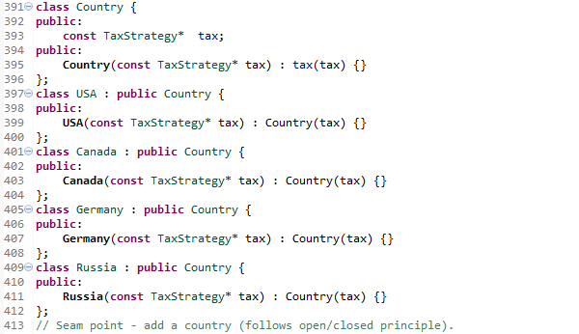
Country Class Hierarchy Expanded

Slide 31
